Slide 1

IT Ticket Analysis
-Vijay Ekka

Slide 2
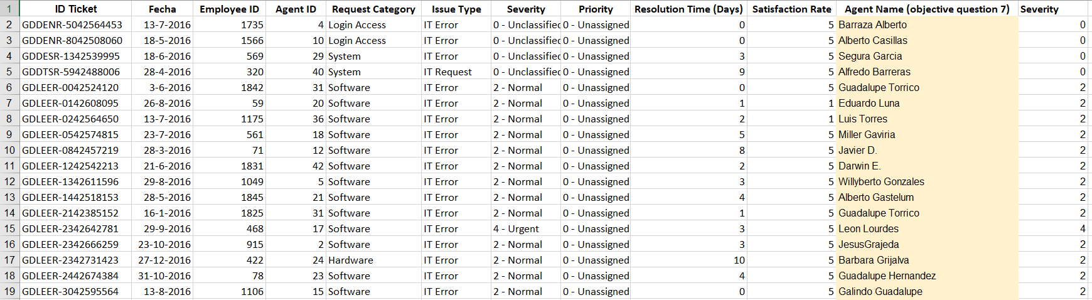
Problem Statement
The objective is to analyze the IT support ticket management system to understand the performance of IT agents, the efficiency of ticket resolution, and the satisfaction levels of employees. The analysis aims to identify high and low performers among IT agents, assess the overall effectiveness of the team, and pinpoint areas for improvement in the ticket resolution process. The ultimate goal is to make informed staffing decisions, including hiring, firing, and training, to enhance overall service quality and team performance.

Slide 3
Data Overview
This analysis is based on a dataset of 97,498 IT support tickets, sourced from an internal service management system, to evaluate help desk performance and identify key trends.
The data is structured into two main files: a Tickets Sheet that tracks every detail of support requests and an IT Agents Sheet with information about the support personnel.
Key performance indicators (KPIs) for this analysis include Resolution Time, which averages 5 days, and Employee Satisfaction, which is measured on a 1-to-5 scale.
The IT help desk manages a consistent workload, handling an average of 53 new tickets each day.
Each ticket is categorized by Request Category (like Login Access or System), Issue Type, Severity, and Priority, allowing for a detailed breakdown of support needs.
By linking the ticket data with the agent data using the Agent ID, we can analyze performance metrics in relation to specific agents and agent demographics.

Slide 4
DDATA SUMMARY
UMMARYDADA
DATASET SUMMARY
The dataset consists of IT support ticket records collected over multiple years. (2016-2020)
It includes two datasets:
Ticket Data (ticket details, severity, priority, resolution time, satisfaction score)
IT Agent Data (agent ID, name and demographic details)
In total, the dataset contains 16 original attributes and covers approximately 97,000+ ticket records handled by 50 IT agents.

Slide 5
DATA CLEANING & PRE-PROCESSING
STEP 1 : Handling Missing Values
Verified missing values using filters across all columns; no blank records were found.
STEP 2 : Removing Duplicates
Verified duplicate entries by using REMOVE DUPLICATES under the data tab and no duplicate values were found.

Slide 6
DATA CLEANING & PRE-PROCESSING
STEP 3 : Standardizing Text and Formats
Used TRIM function to remove extra white space in the columns.
Extracted text and numeric values of SEVERITY column in different columns for better insights.
STEP 4 : Data Enrichment
Created additional columns other than from raw data to provide more detailed information.
For Example :
Created different ‘Year’ and ‘Quarter’ column to provide yearly and quarterly trend of IT tickets.
Created ‘Age Group’ and ‘Seniority Level’ columns to look into agent performance based on their demographic details.

Slide 7
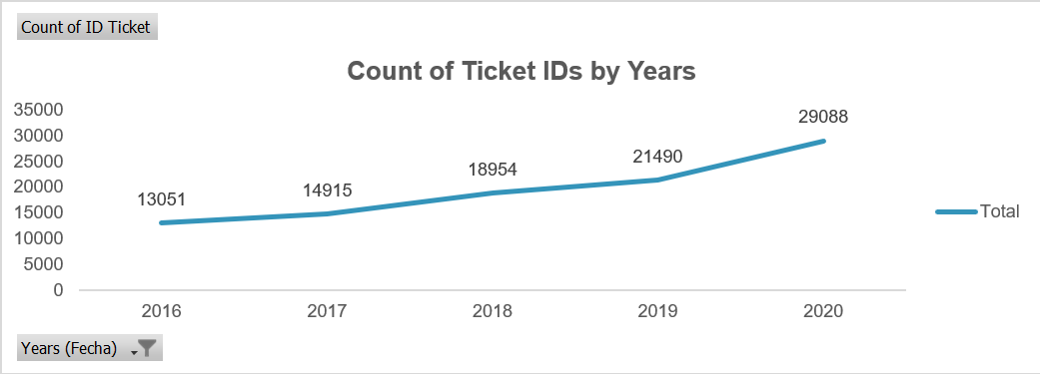
TICKET VOLUME TREND ANALYSIS (2016-2020)
📈 Consistent Growth Trend : Ticket volume shows a steady increase from 2016 to 2020 indicating continuous growth in IT support demand.
👥 Rising Workload Pressure : Increasing ticket numbers indicate growing workload pressure on the IT support team.

Slide 8
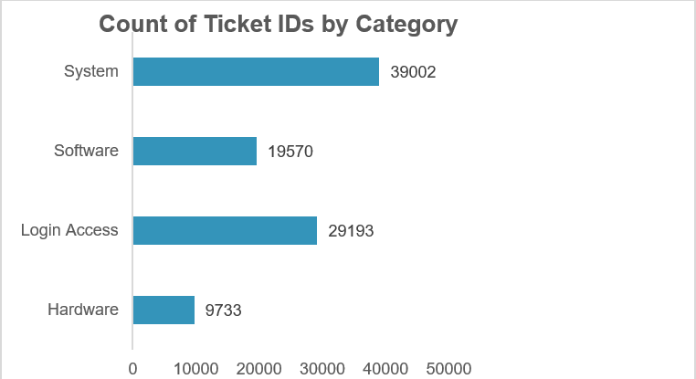
TICKET DISTRIBUTION BY REQUEST CATEGORY
The average daily ticket volume is 53.
System and Login Access categories account for the vast majority of IT requests.
Hardware has the lowest ticket volume but the longest resolution time.
System issues account for 40% of tickets, Login Access 30%, Software 20% and Hardware 10%

Slide 9
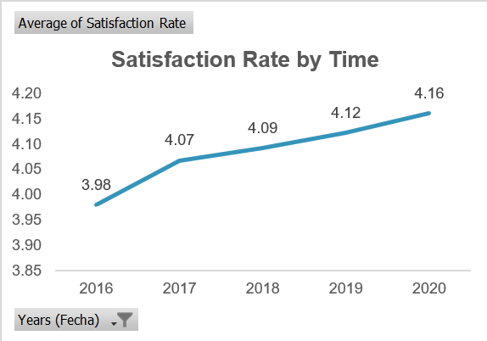
SATISFACTION RATE OVER TIME (2016-2020)
😊 Consistently High Satisfaction Levels : Customer satisfaction remains stable and high (around 4+) throughout the observed period.
🔧 Service Quality Maintained Despite Ticket Growth : Even with increasing ticket volume satisfaction levels have not declined reflecting effective issue resolution.

Slide 10
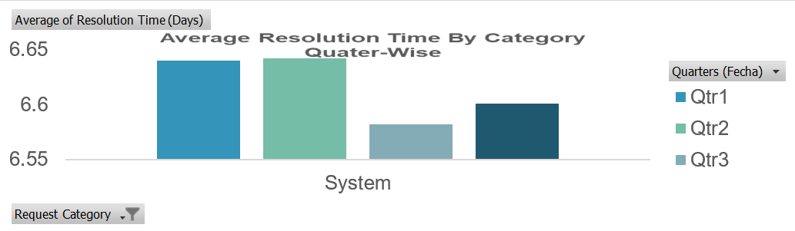
RESOLUTION TIME EFFICIENCY ANALYSIS BY REQUEST CATEGORY
Hardware issues take the longest to resolve 7.63 days.
System issues average 6.62 days.
Software requests average 5.24 days.
Login Access requests are resolved very quickly (0.31 days).
Hardware resolution is a systemic issue affecting all agent age groups.

Slide 11
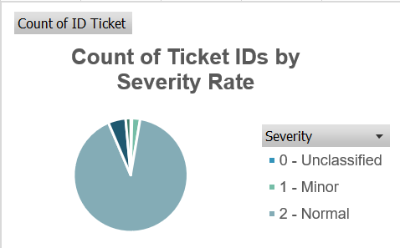
SEVERITY-BASED IT TICKET DISTRIBUTION ANALYSIS
📌 Majority of Tickets Fall Under “Normal” Severity : Most tickets are classified as Severity 2 (Normal) indicating routine operational issues form the bulk of IT support requests.
❓ Minimal Unclassified Tickets : Very few tickets remain unclassified indicating good ticket categorization practices.

Slide 12
Recommendations
Improve System Stability
Strengthen login & access management
Optimize Agent Allocation
Improve Severity-Based Workflow
Upgrade Ticket Management Tools
Prioritize proactive monitoring and preventive maintenance for system-related issues.
Automate password resets and access-related requests.
Balance ticket distribution across agents using workload based assignment.
Redesign severity based workflows to prevent prolonged resolution of normal severity tickets.
Invest in upgrading the ticket management software with better automation, categorization and tracking features.
Overall Impact: These recommendations focus on reducing recurring issues, improving response efficiency and enhancing customer satisfaction through data driven decision making.

Slide 13
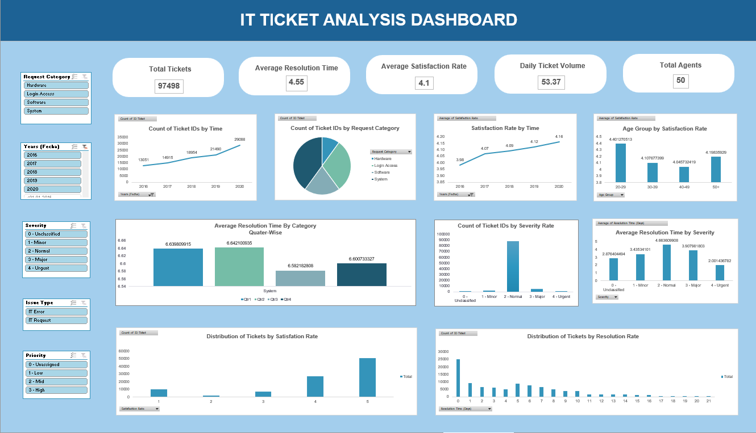
Dashboard

Slide 14
CONCLUSION
The analysis reveals clear patterns in ticket volume, resolution time and satisfaction levels across categories and time periods.
Certain request categories and time periods require higher technical effort leading to longer resolution times.
Agent performance and workload distribution indicate opportunities for process optimization and skill enhancement.
The dashboard provides a centralized, real-time view of IT support performance enabling faster and data-driven decisions.
Overall, the insights support strategic investments in technology, training and resource allocation to improve efficiency and user satisfaction.

